Slide 1


SOLID
Principles
By Rahul Timbaliya

Slide 2

Agenda
Introduction of Principle & Programming Paradigms
Introduction of SOLID Principle
References
Question & Answers
Thank You

Slide 3

Programming Paradigms
Procedural-Oriented Programming (POP):
POP is more focused on procedures or functions rather than objects.
It revolves around writing procedures or routines to accomplish tasks.
It doesn't emphasize data abstraction or encapsulation as much as OOP.
POP is straightforward and is often suitable for smaller programs or scripts where the emphasis is on the steps to perform a task rather than on managing complex data structures.
Object-Oriented Programming (OOP):
In OOP, the program is organized around objects rather than actions and data rather than logic.
It emphasizes modularity by dividing software into objects that represent real-world entities.
Key concepts include classes, objects, inheritance, polymorphism, and encapsulation.
OOP aims to increase code reuse and maintainability by grouping related behaviors and data into cohesive units (objects).

Slide 4
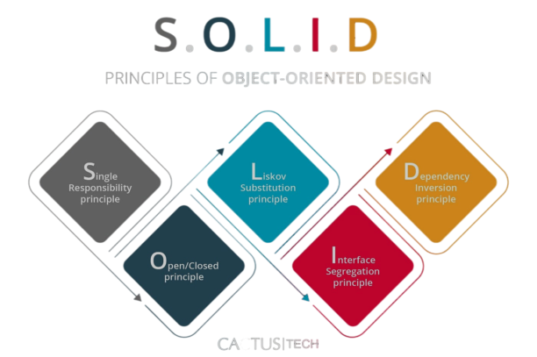
S.O.L.I.D

Slide 5
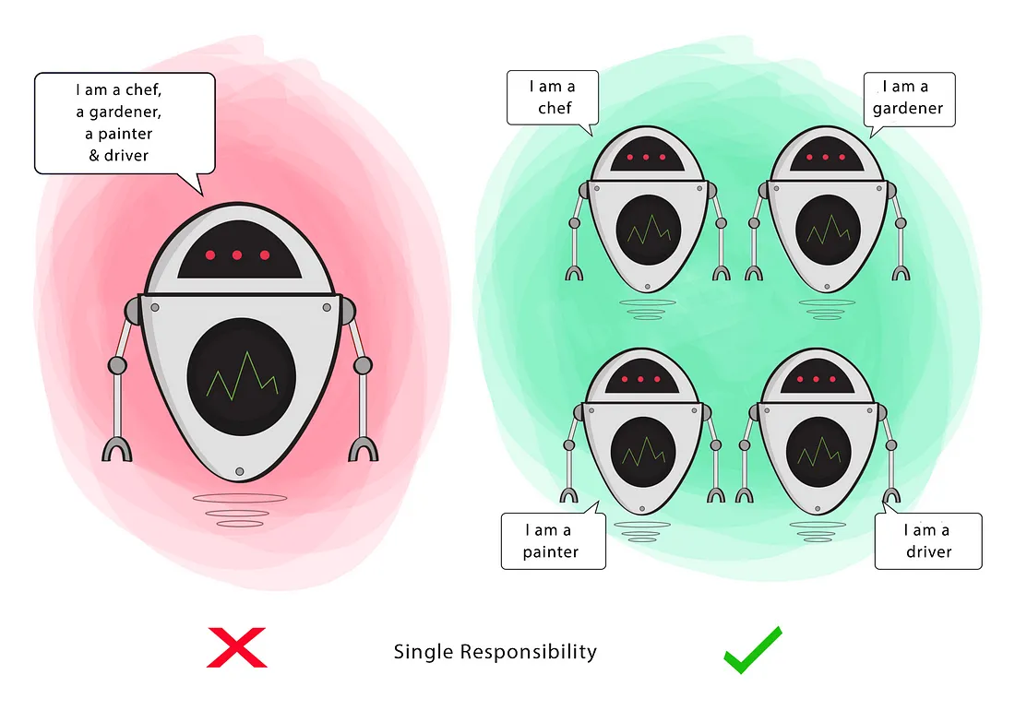
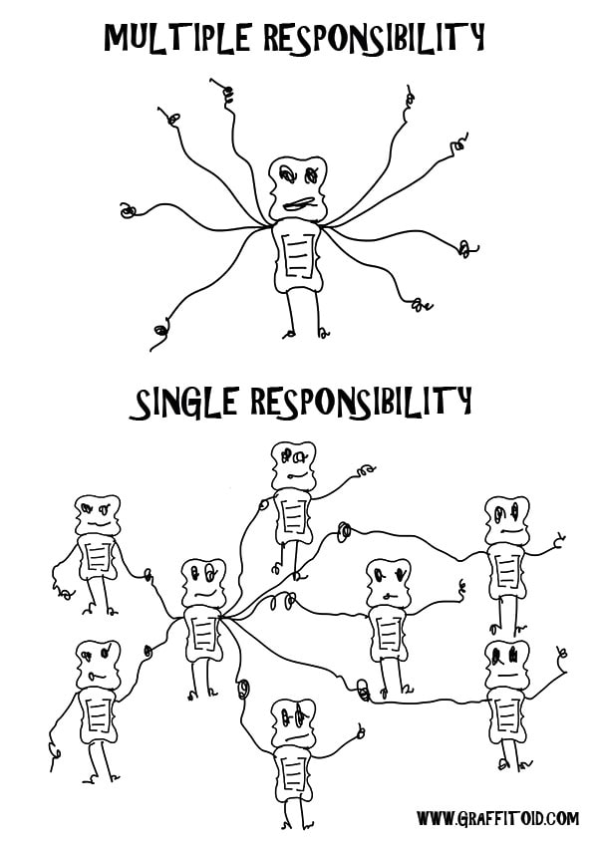
Single Responsibility Principle
Definition: The Single Responsibility Principle states that a class should have only one reason to change. In other words, a class should be responsible for only one aspect of the system's functionality.
Importance:
Promotes modular design: Breaking down complex systems into smaller, focused components makes the codebase more manageable and easier to understand.
Improves maintainability: When each class has a single responsibility, changes related to that responsibility are isolated, reducing the risk of unintended side effects.

Slide 6
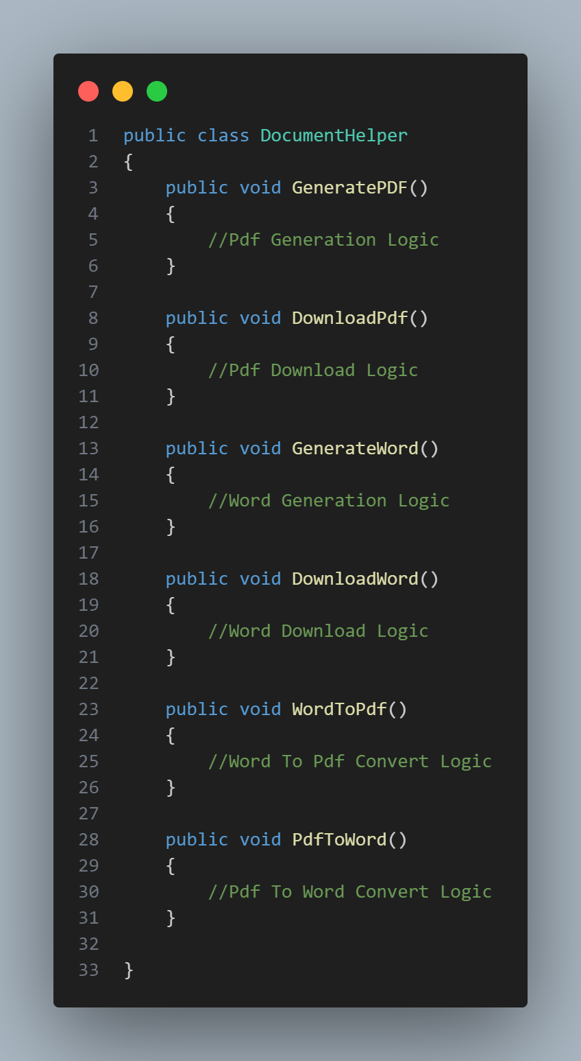
Violating Single Responsibility Principle

Slide 7
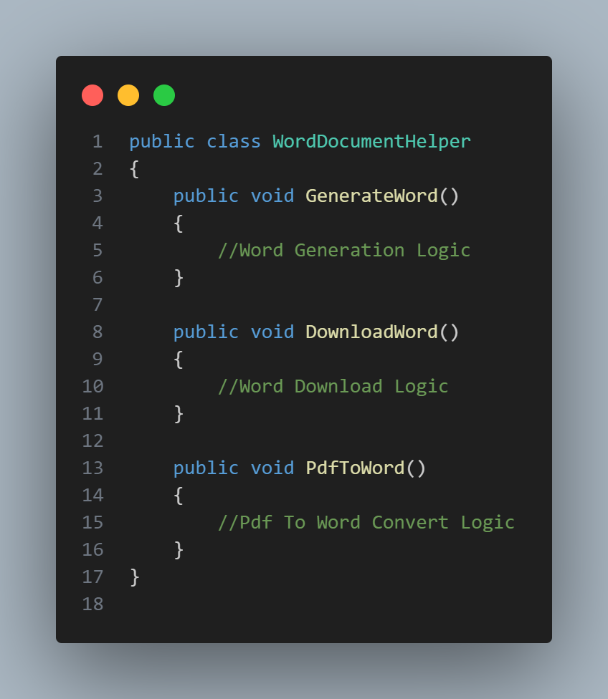
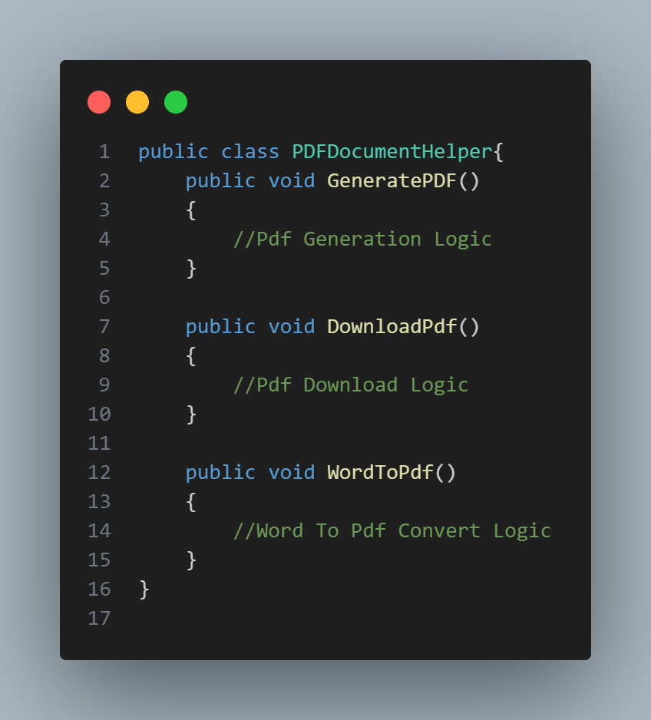
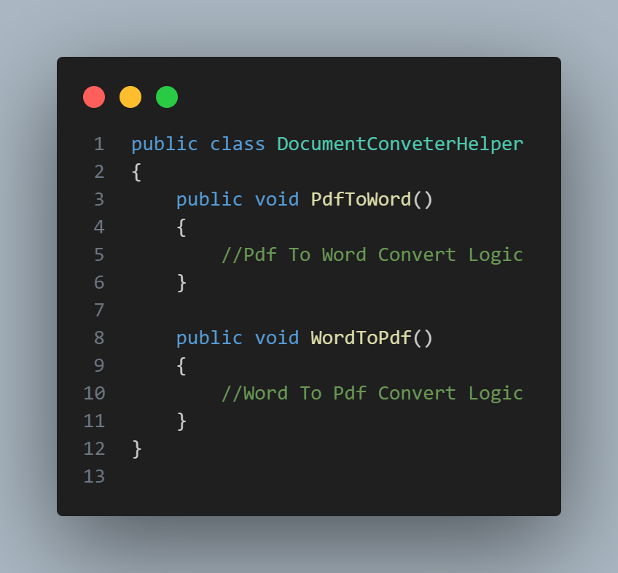
Single Responsibility Principle
Example

Slide 8
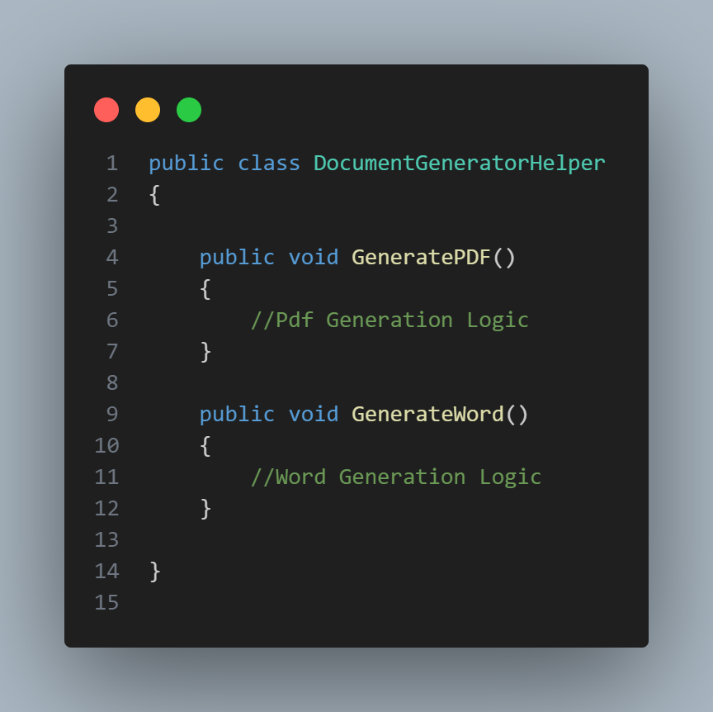
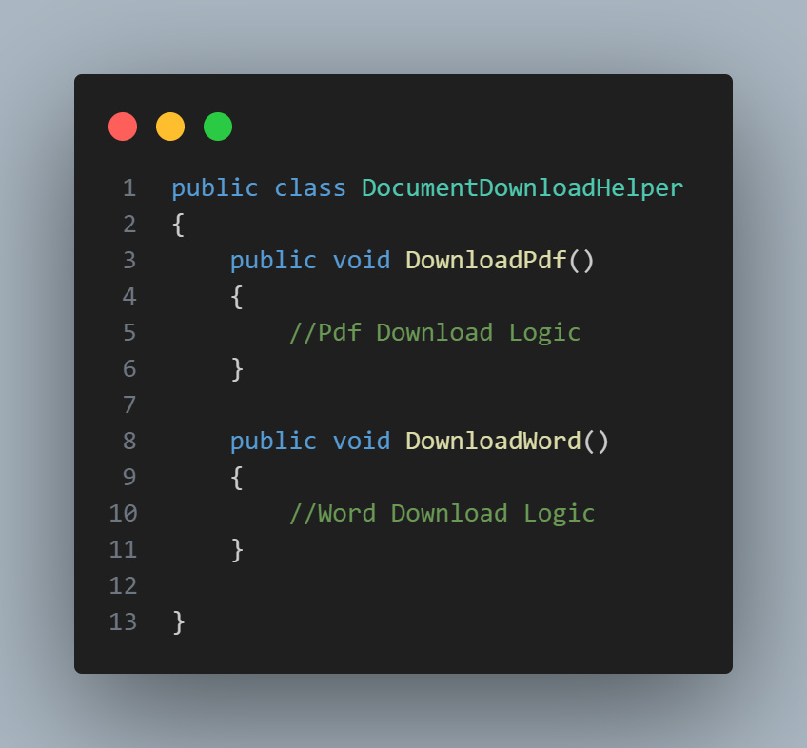
Single Responsibility Principle
Example

Slide 9
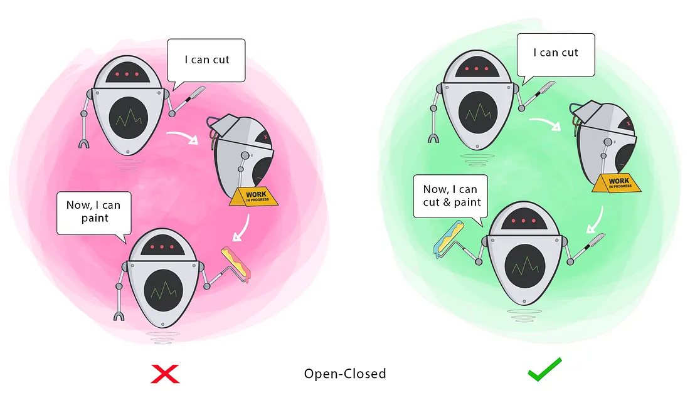
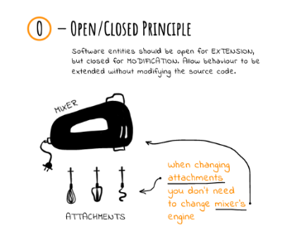
Open/ Closed Principle
Definition: The Open/Closed Principle states that software entities (classes, modules, functions, etc.) should be open for extension but closed for modification. This means that existing code should not be modified to add new functionality; instead, it should be extended through inheritance.
Importance:
Encourages code reuse: By designing classes to be easily extensible, developers can add new features without altering existing code, promoting reuse and reducing the risk of introducing bugs.
Enhances maintainability: Because existing code remains unchanged, there's less chance of inadvertently introducing errors while making modifications.

Slide 10
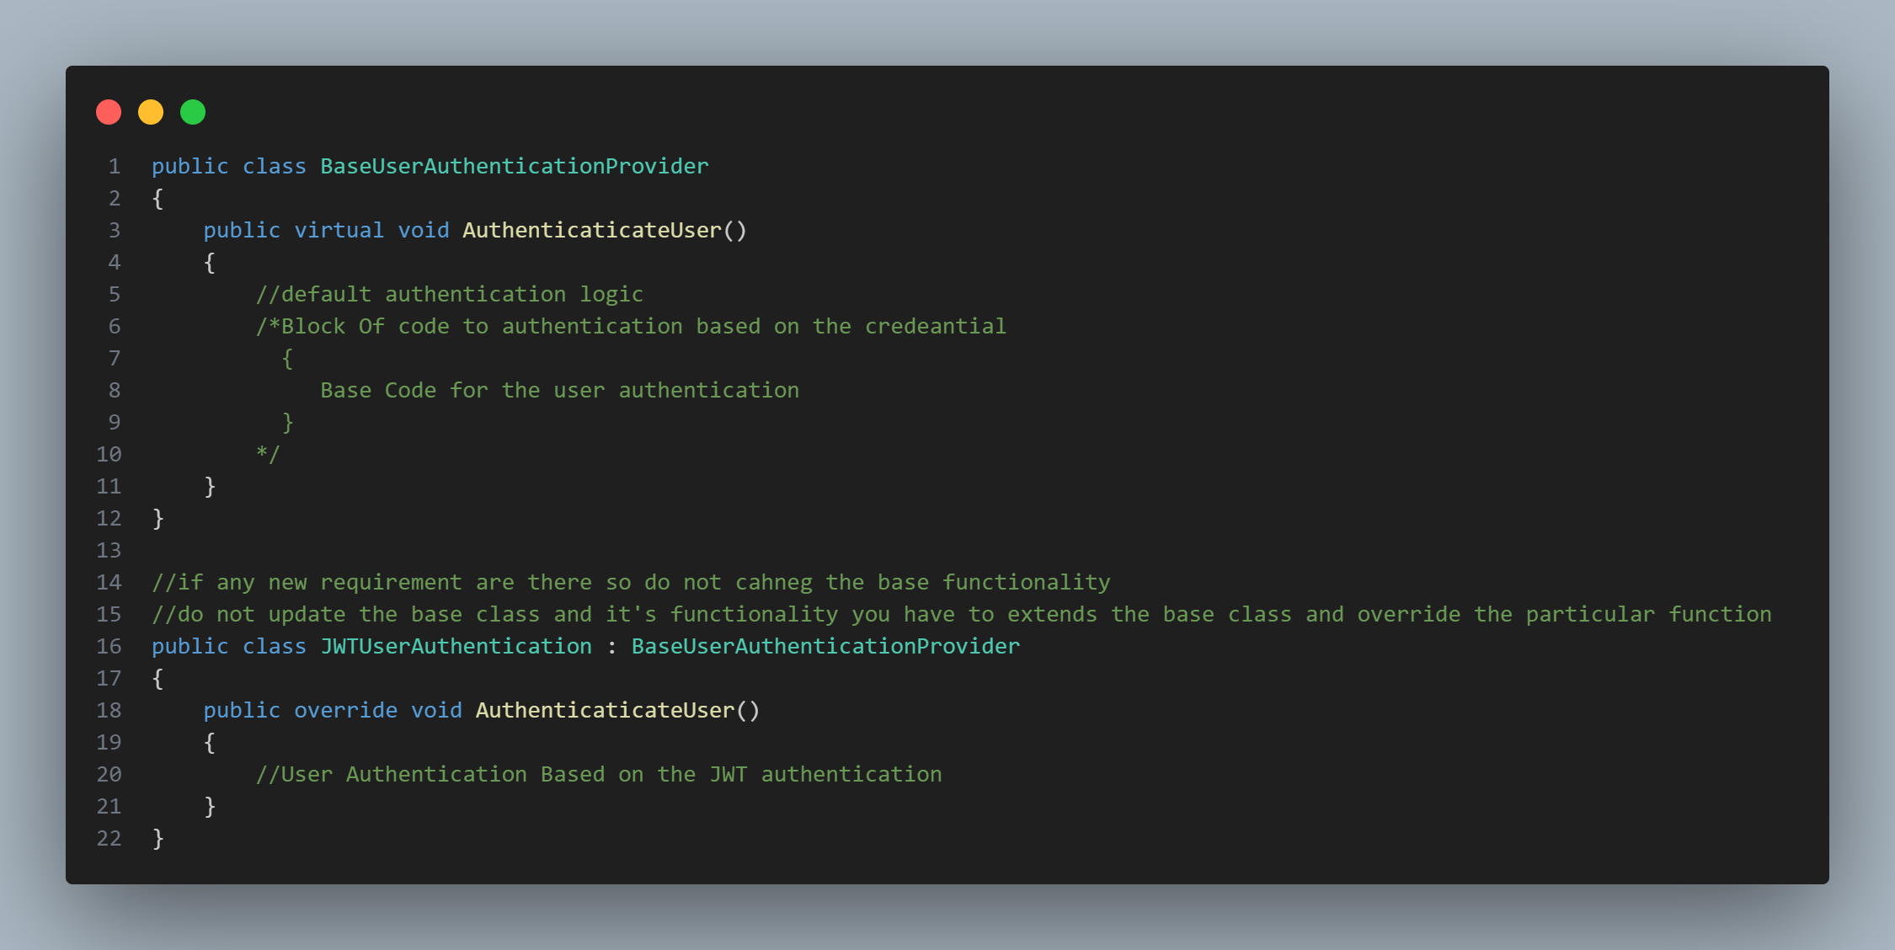
Open/Close Principle
Example

Slide 11
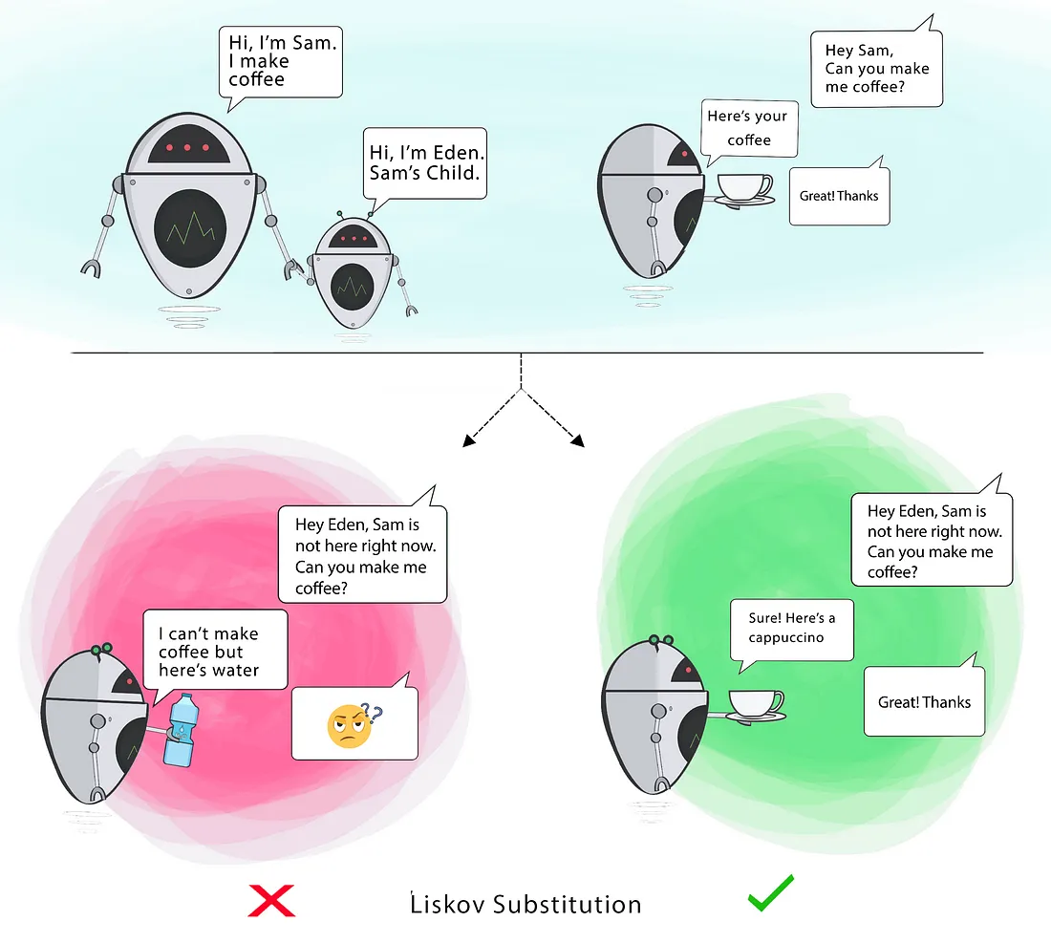
Lisko Substitution Principle
Definition: The Liskov Substitution Principle states that objects of a superclass should be replaceable with objects of its subclasses without affecting the correctness of the program. In other words, subclasses should be able to substitute their base class without changing the behavior expected by clients
Importance:
Ensures interoperability: Clients should be able to use objects of subclasses interchangeably with objects of the superclass without encountering unexpected behavior.
Promotes polymorphism: By adhering to LSP, developers can leverage polymorphism to write more flexible and maintainable code.

Slide 12
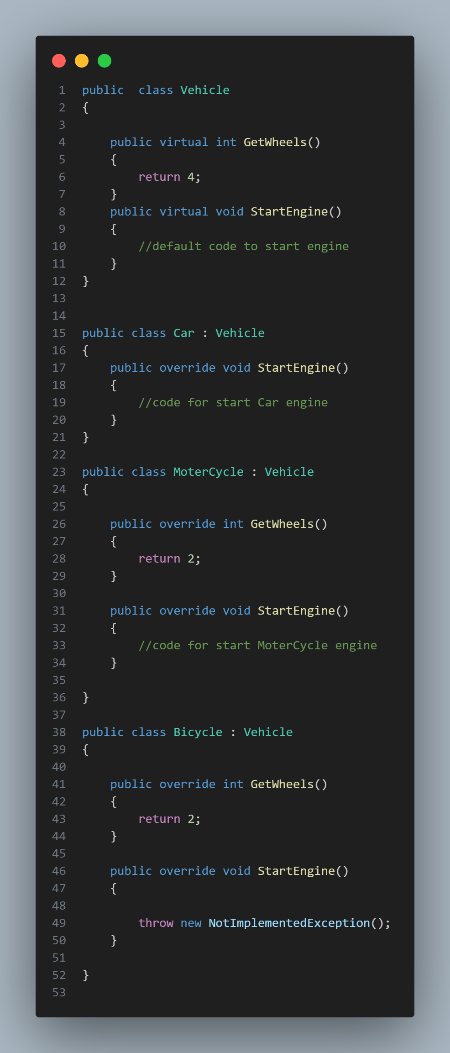
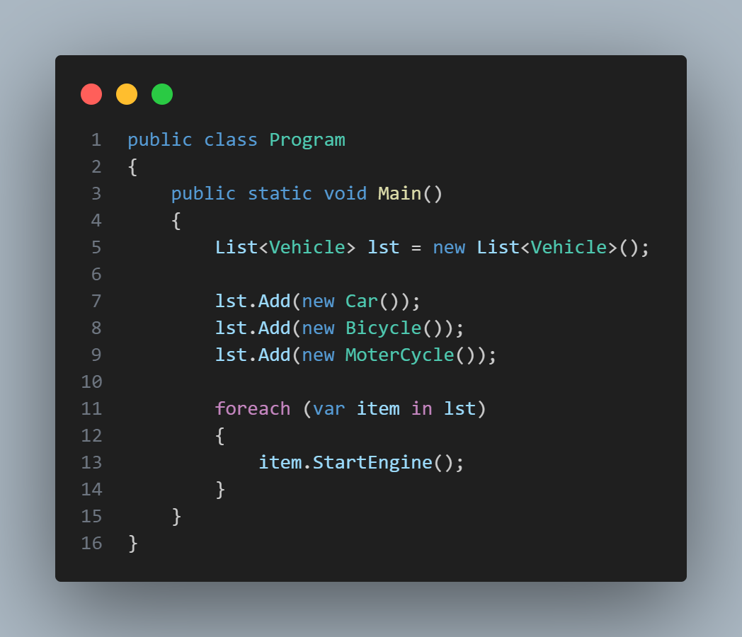
Violating Lisko Substitution Principle

Slide 13
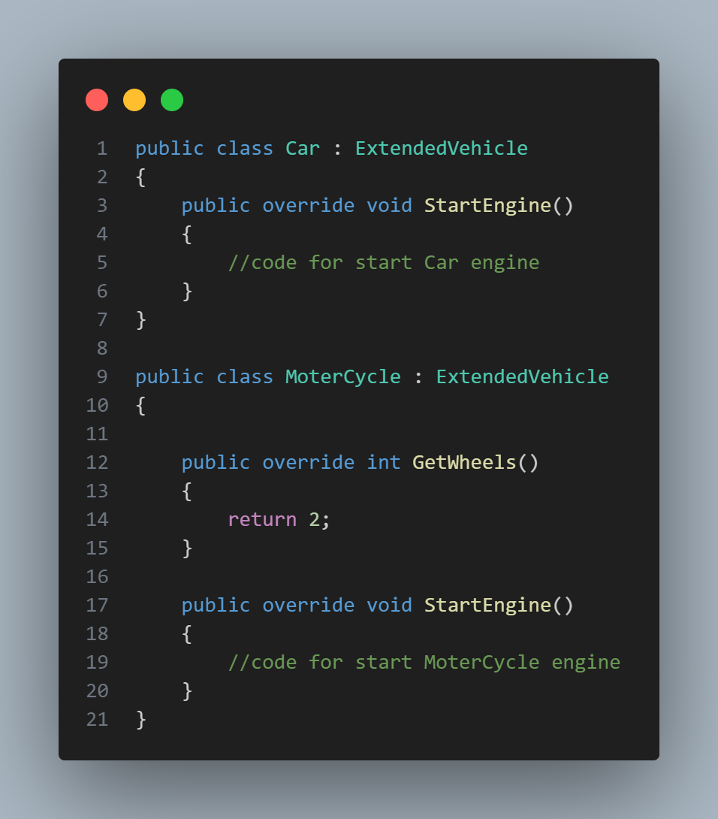
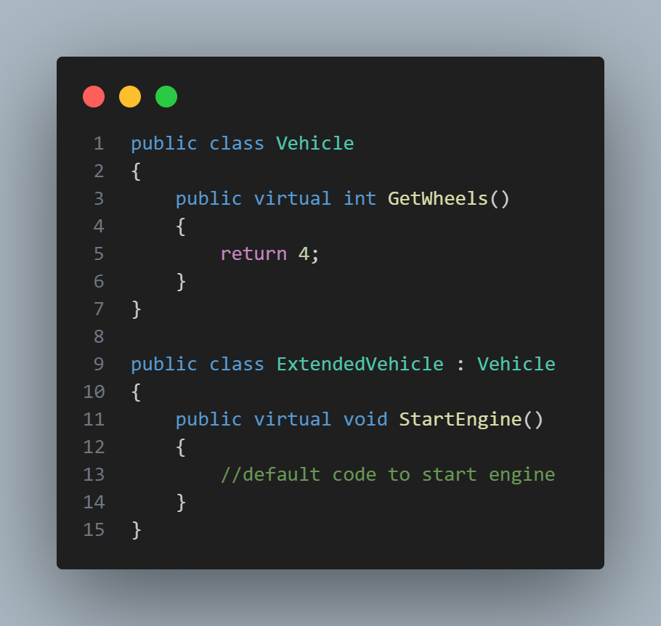
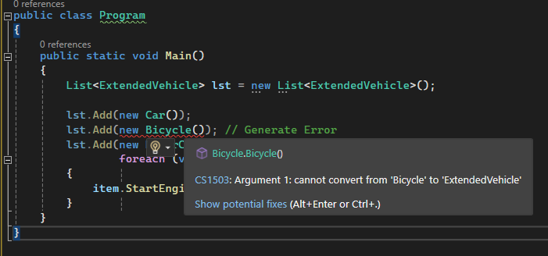
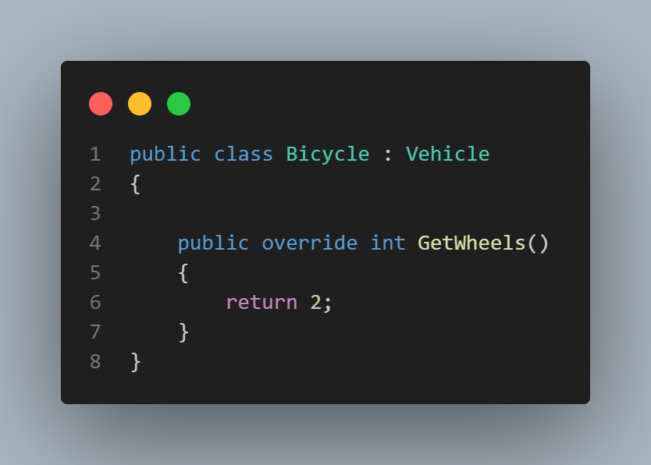
Lisko Substitution Principle

Slide 14
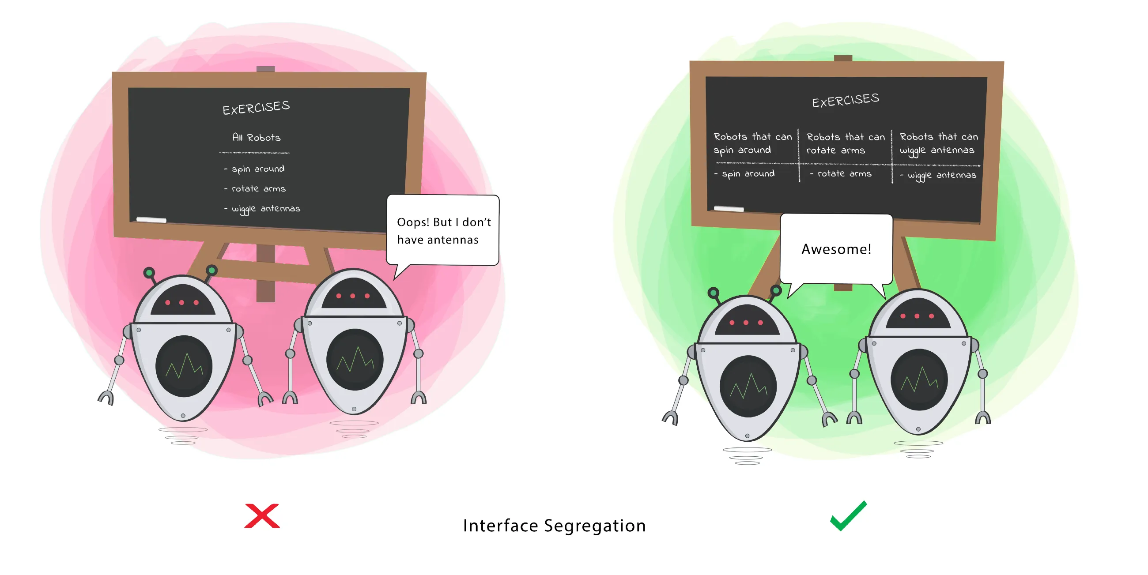
Interface Segregation Principle
Definition: The Interface Segregation Principle states that clients should not be forced to depend on interfaces they do not use. In other words, interfaces should be tailored to the specific needs of clients to avoid unnecessary dependencies.
Importance:
Ensures interoperability: Clients should be able to use objects of subclasses interchangeably with objects of the superclass without encountering unexpected behavior.
Promotes polymorphism: By adhering to LSP, developers can leverage polymorphism to write more flexible and maintainable code.

Slide 15
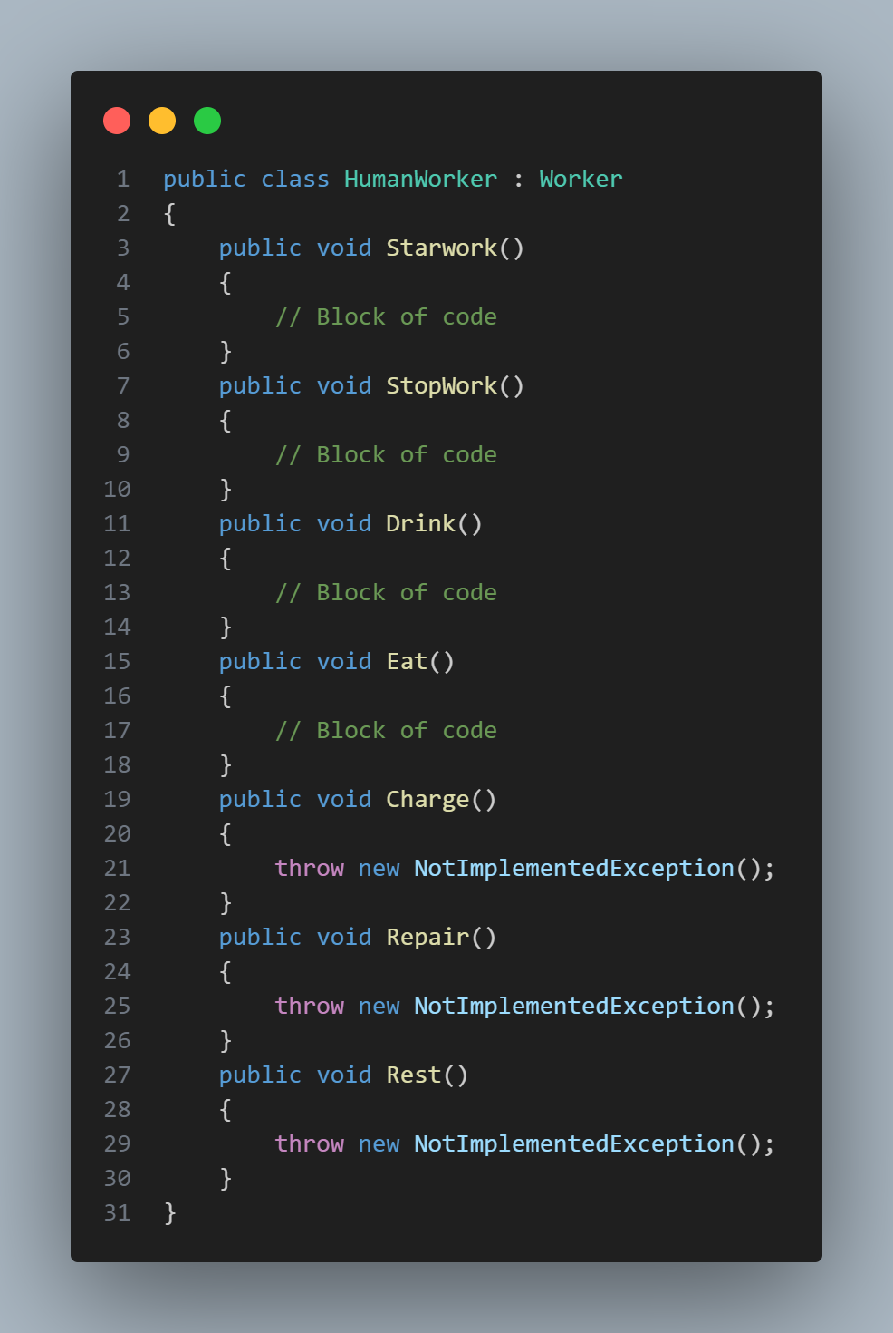
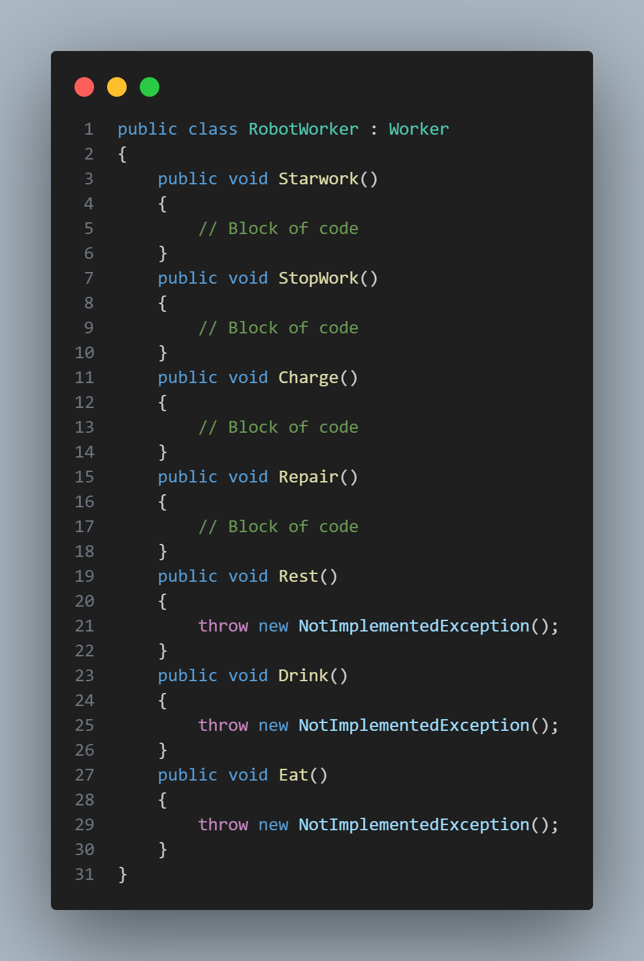
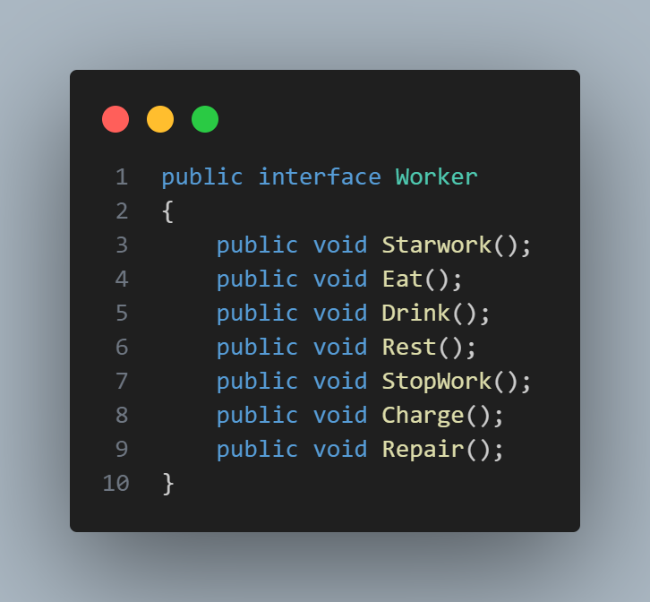
Violating Interface Segregation Principle

Slide 16
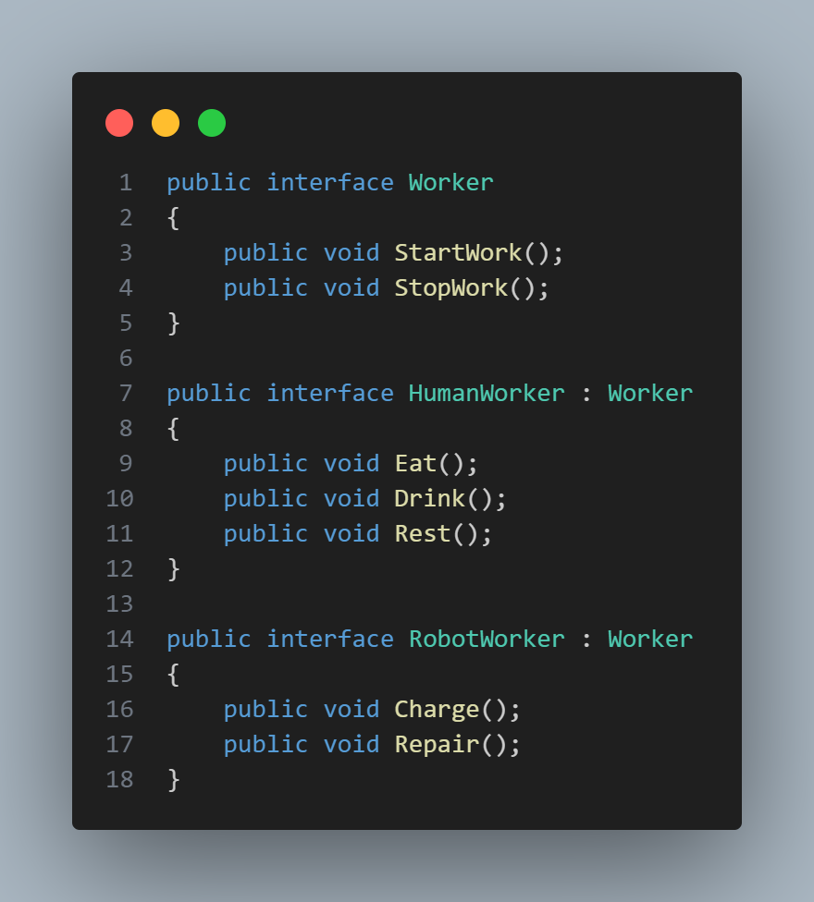
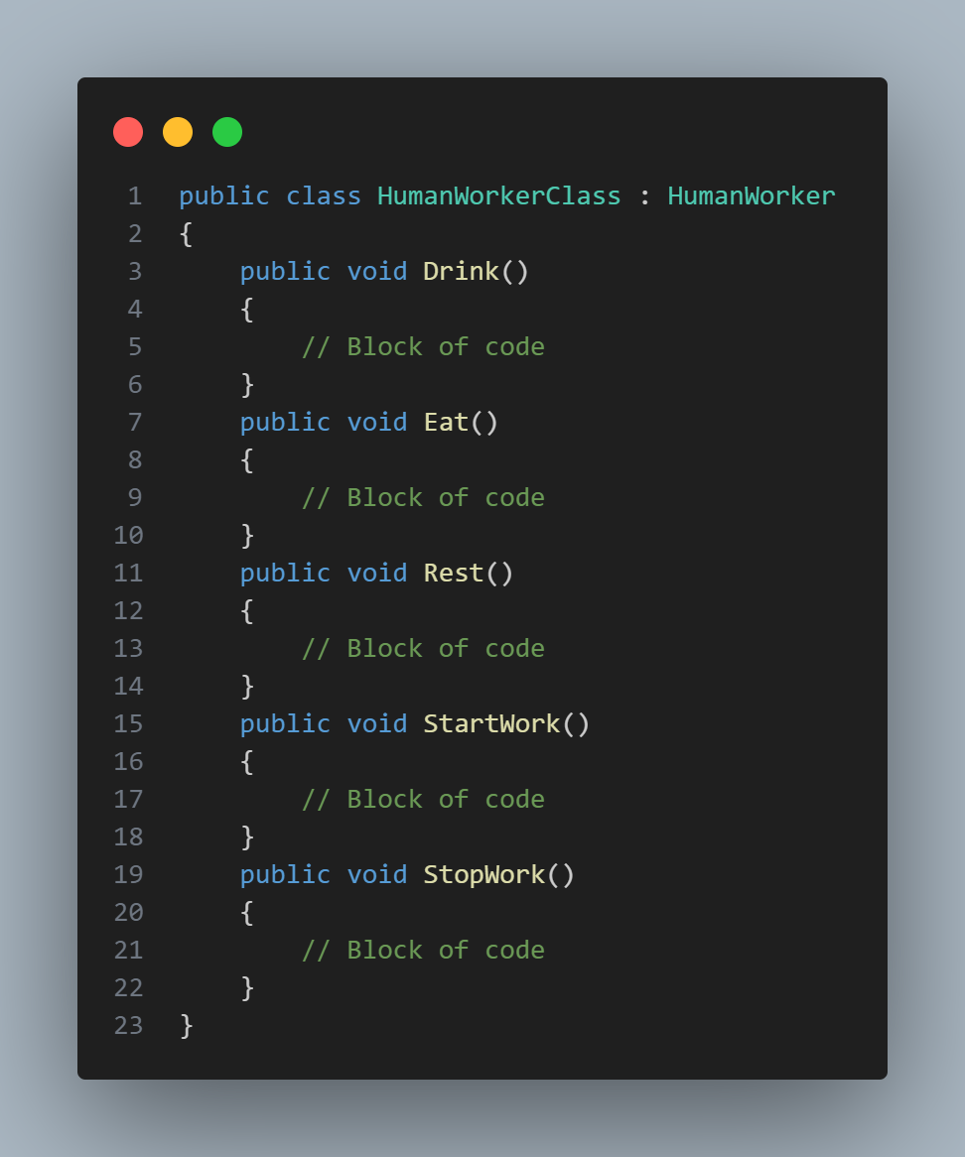

Interface Segregation Principle
Example

Slide 17
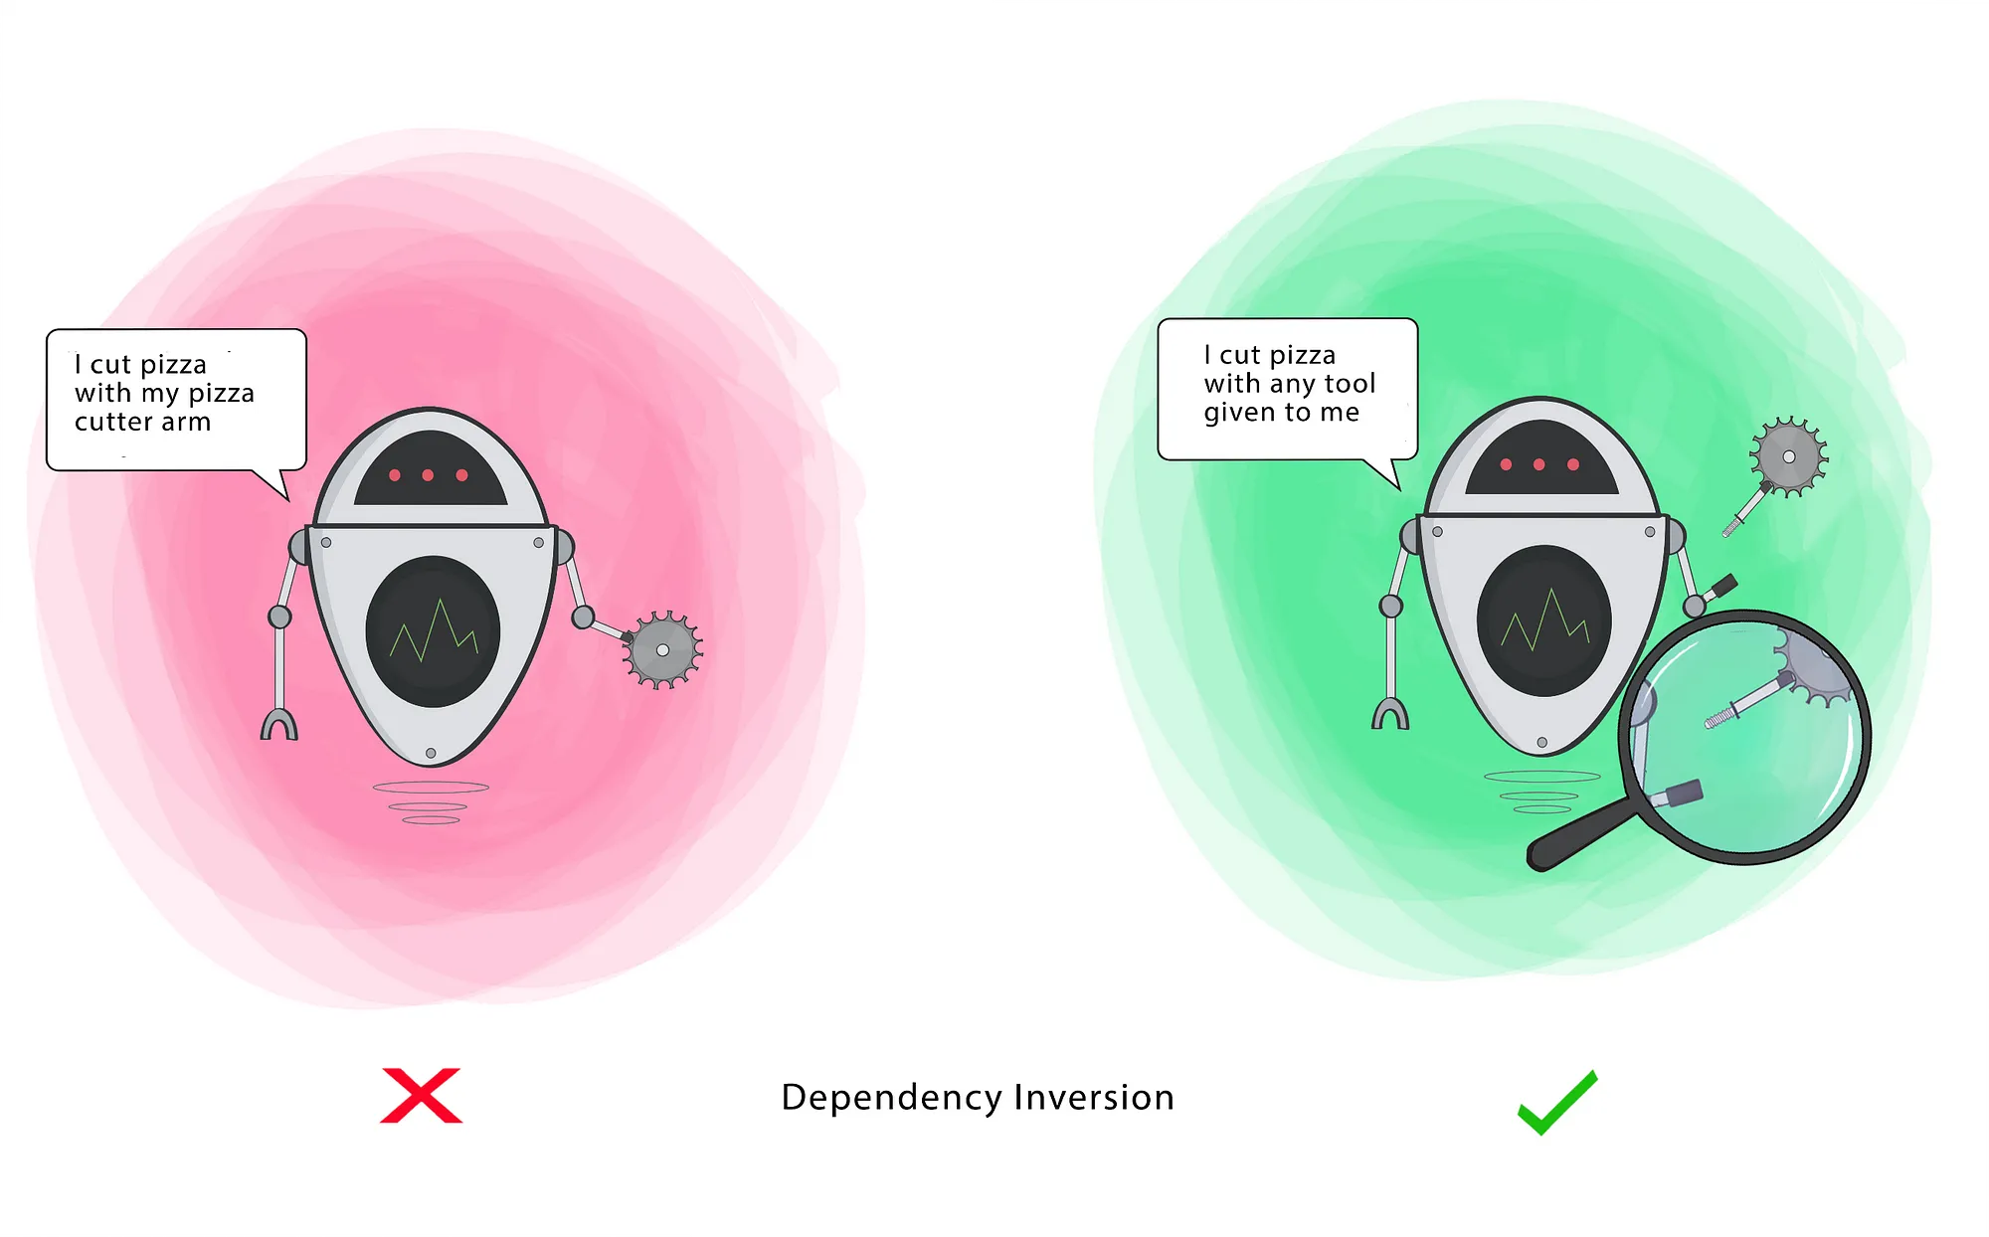
Dependency Inversion Principle
Definition: The Dependency Inversion Principle states that high-level modules should not depend on low-level modules. Instead, both should depend on abstractions. This principle promotes decoupling between modules and facilitates easier maintenance and testing.
Importance:
Reduces coupling: By depending on abstractions rather than concrete implementations, modules become less coupled, making it easier to replace or modify components without affecting the entire system.
Enables unit testing: Abstractions allow for easier mocking and stubbing in unit tests, facilitating more thorough and isolated testing of individual components.

Slide 18
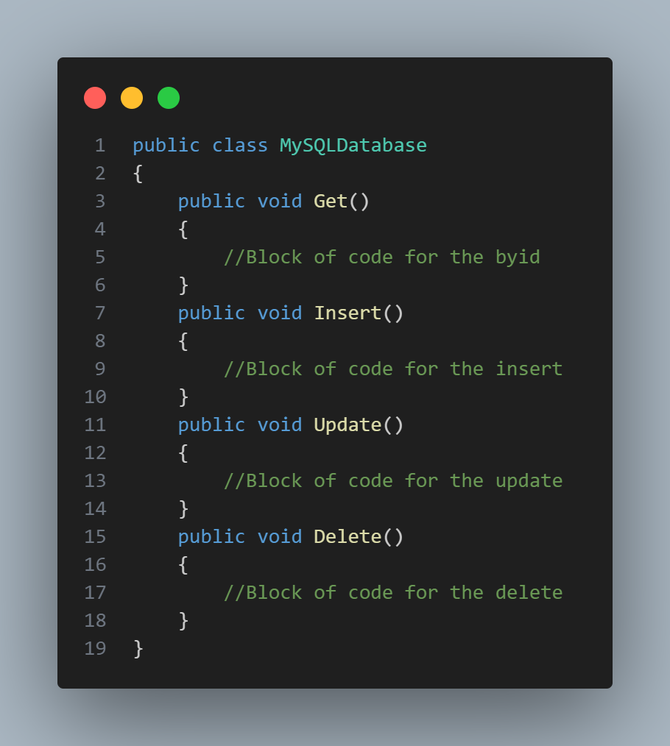

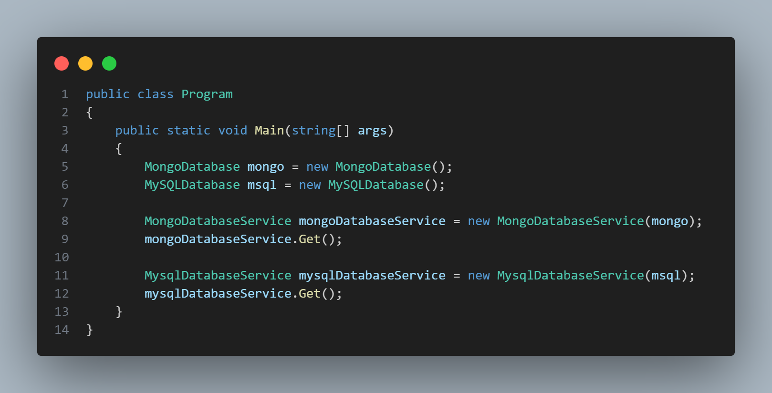
Violating Dependency Inversion Principle

Slide 19
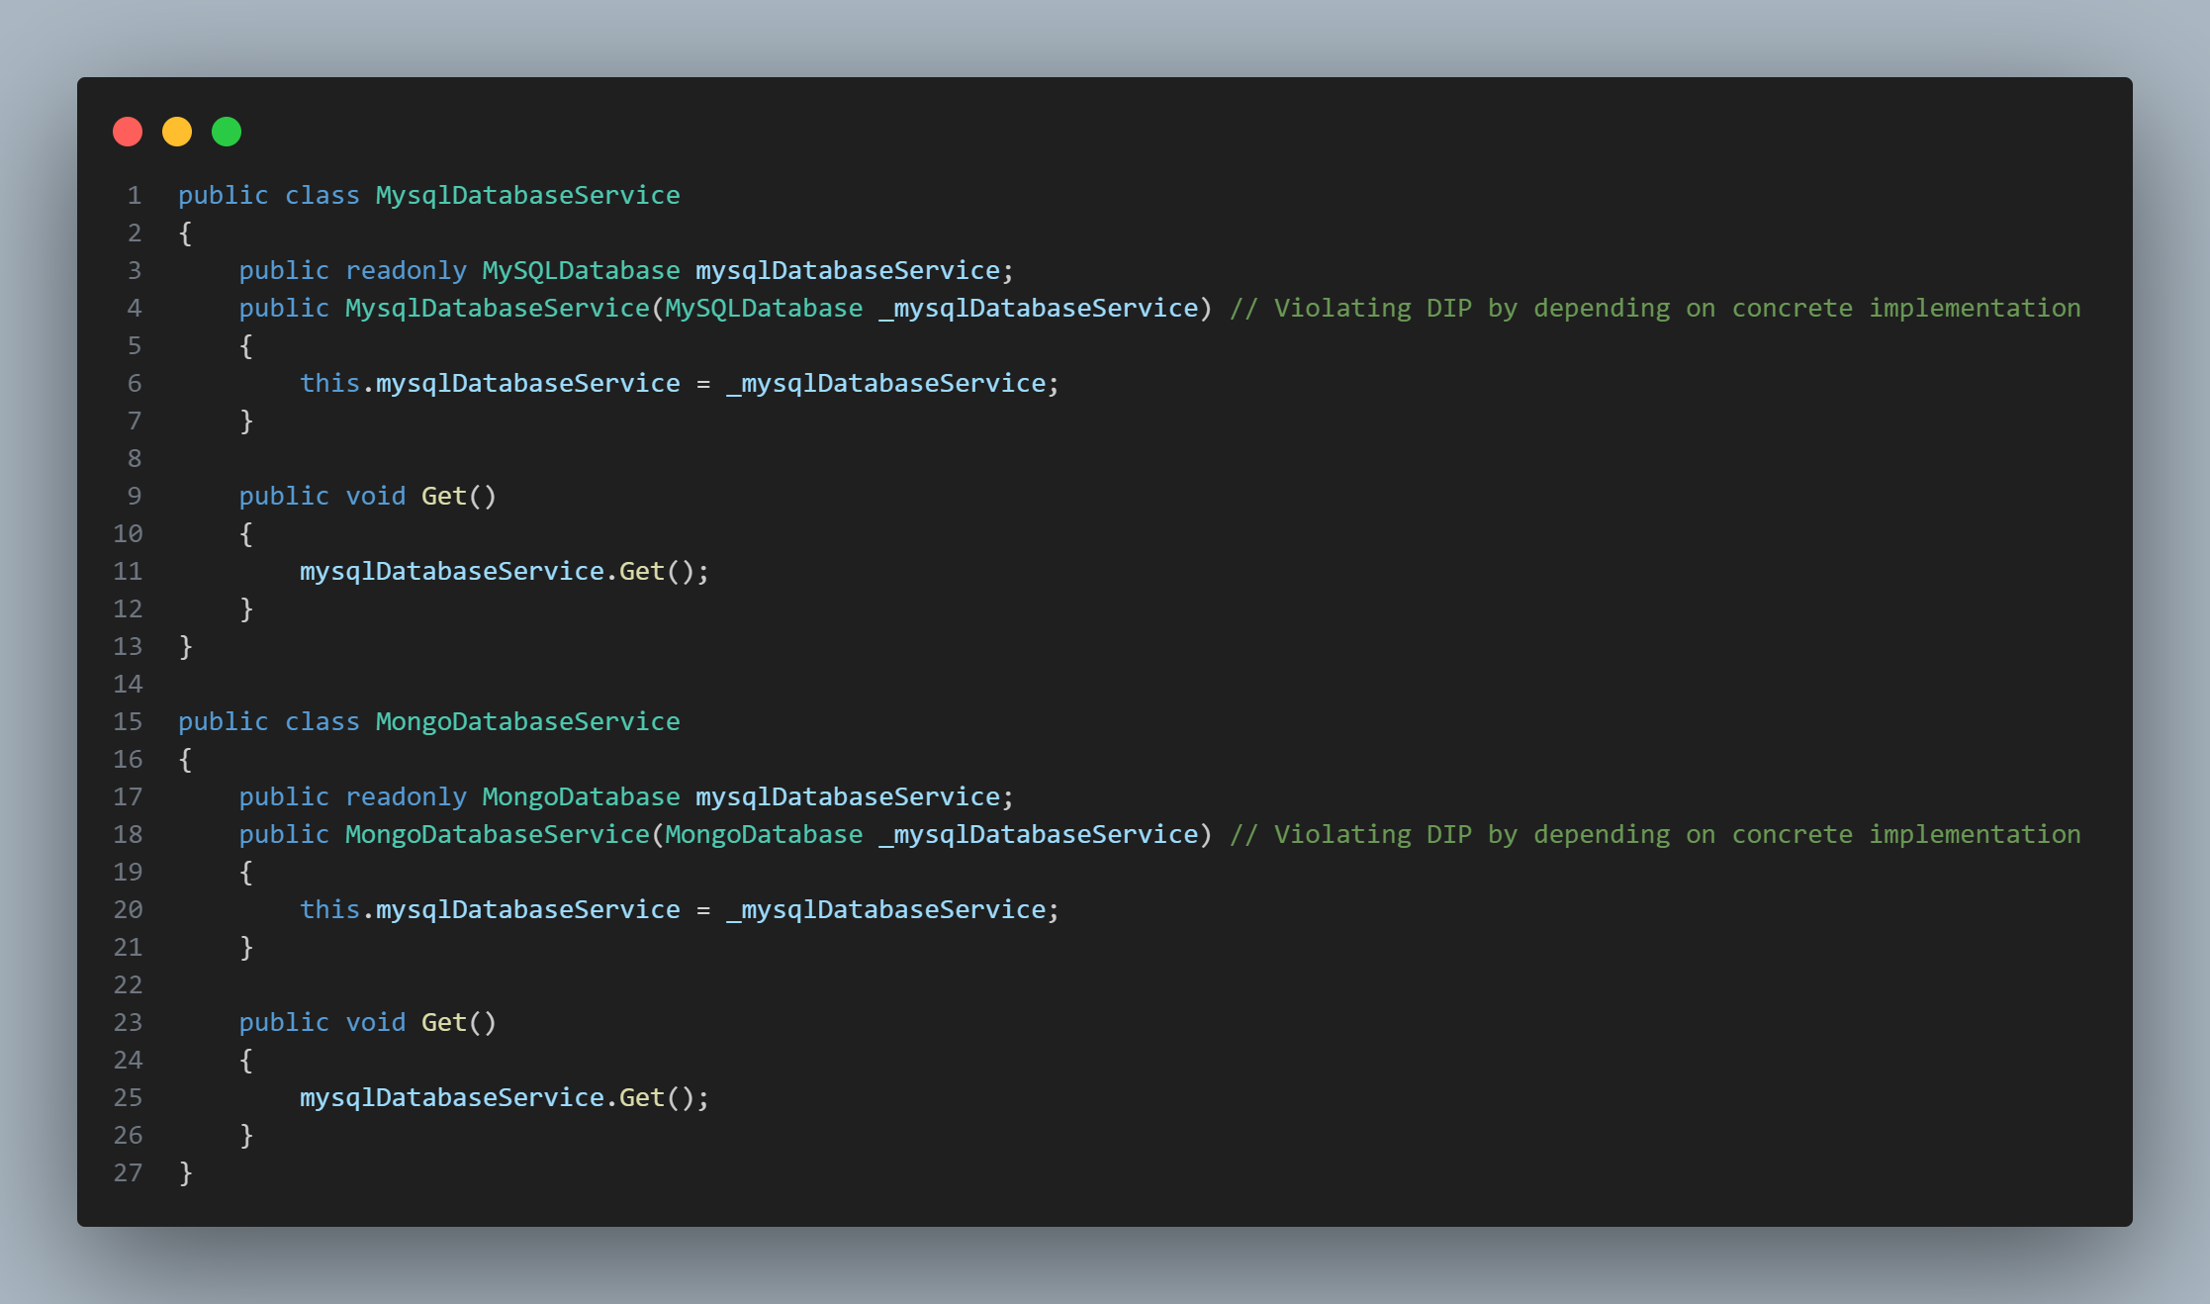

Slide 20

Question ?

Slide 21
Thank you

